Slide 1

Retail Banking Transaction Analysis

Slide 2
About me
Name:Shriya
Education:B.Tech in Information Technology
Why Data Science:To build analytical skills,work with real-world datasets and turn data into useful business insights.
LinkedIn:https://www.linkedin.com/in/punati-shriya-9b3737259/
GitHub: https://github.com/shriya2004

Slide 3
Table of contents
Project Overview
Business Scenario
Business Objectives
Dataset & Database Overview
ER Diagram & Database Structure
Analysis of the Objectives
Overall Key Findings
Business Recommendations
Conclusion
Q&A

Slide 4
Project Overview
Retail Bank Transaction Analysis is a SQL-based project designed to
analyse banking data and identify useful patterns in customer
behaviour, account activity, transactions, loans, repayments, and cards.
Tools: MySQL and SQL queries using filtering,joins,aggregation,grouping,
and calculations.

Slide 5
Business Scenario
A retail bank provides different financial services to customers, including deposit accounts, money transfers, loans, and debit and credit cards.
The bank needs to understand how customers use these services, whether transactions are completed successfully, and whether loan repayments are being made on time.
Business problem: How can the bank use its stored data to better understand customers, monitor transaction outcomes, identify potential loan risks, and improve its services?
Expected outcome: Data-driven findings that can help the bank improve operational monitoring, customer engagement, and loan management.

Slide 6
Business Objectives
Objective 1: Customer Analysis
Analyse customer segments, product ownership, and relationships across accounts, loans, and cards.
Objective 2: Account Analysis
Compare account types, active and closed accounts, balances, interest rates, and regional patterns.
Objective 3: Transaction Analysis
Examine transaction types, amounts, channels, statuses..
Objective 4: Loan and Repayment Analysis
Analyse loan products, loan statuses, outstanding amounts, payment statuses, and late repayments.
Objective 5: Card Analysis
Compare debit and credit cards, card networks, customer segments, and card-related financial measures.

Slide 7
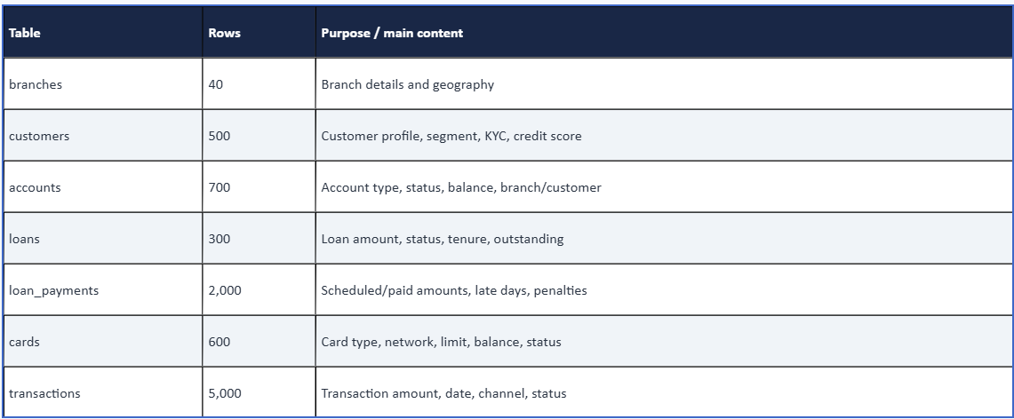
Dataset & Database Overview

Slide 8
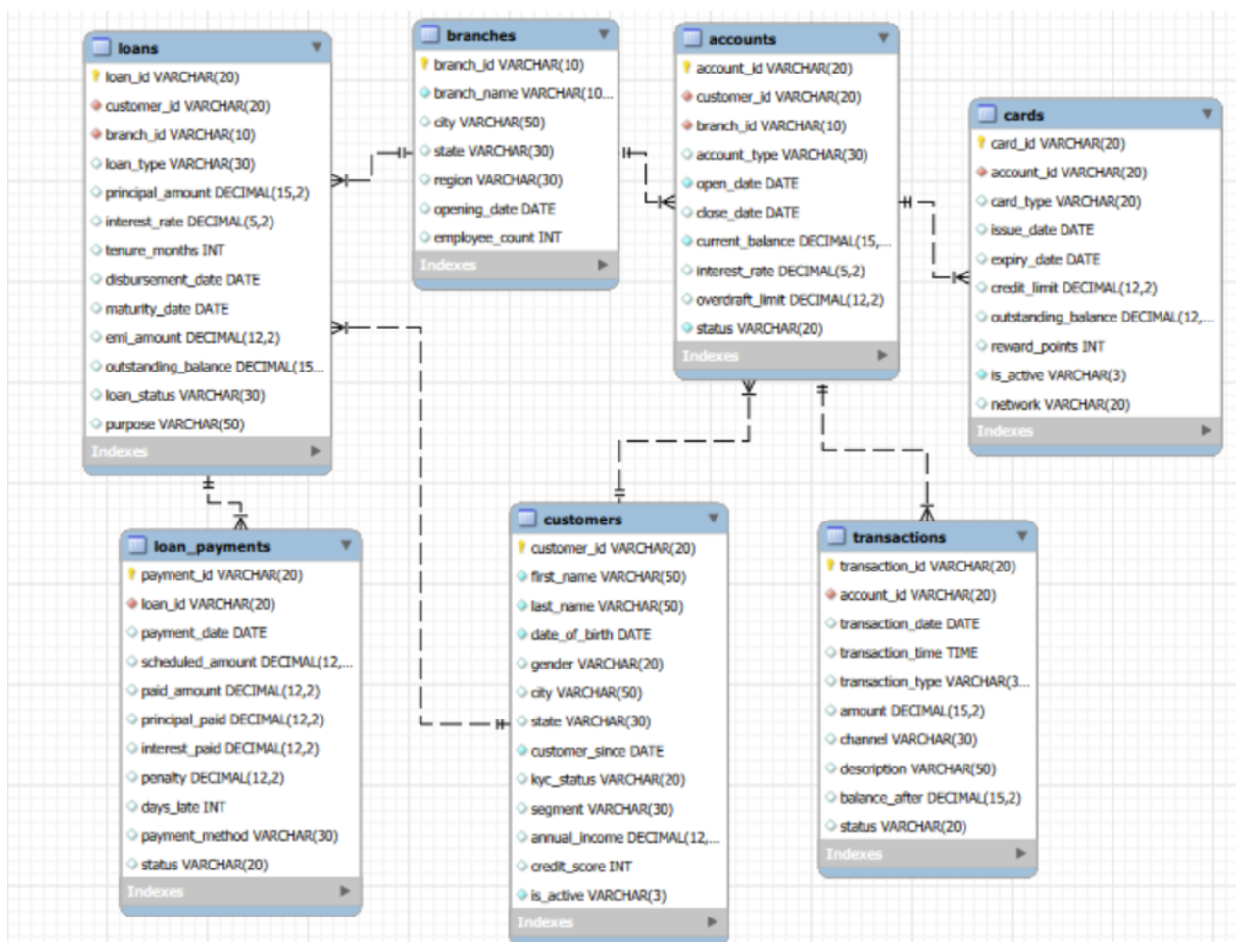
ER Diagram & Database Structure

Slide 9
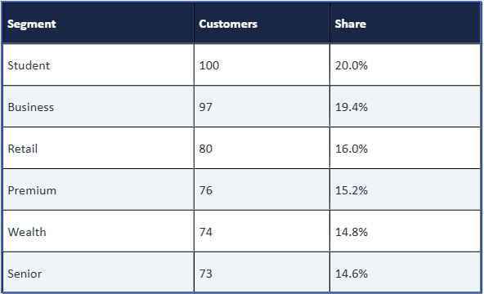
Analysis of the Objectives
Objective-1:Customer Segmentation
The Student and Business segments represent the largest customer groups. This indicates an opportunity to develop services that meet the needs of students and business customers.
KYC analysis showed that 375 customers were verified, while 125 customers were not verified. This means that 75% of customers have completed KYC verification, while 25% have not.
Gender distribution showed 190 Male customers (38%), 156 Non-binary customers (31.2%), and 154 Female customers (30.8%).
The customer base is distributed across multiple segments, allowing the bank to design targeted products and services instead of using the same approach for every customer group.

Slide 10
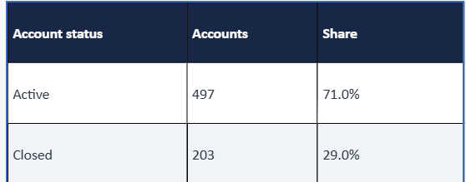
Objective-2:Account Analysis
Most accounts are active, indicating that the bank has substantial base of currently operating accounts. However, the 203 closed accounts may be worth investigating to understand possible customer attrition.
IRA accounts are the most common, with 136 accounts. Certificate of Deposit accounts have 118, Savings accounts have 117, Business Checking accounts have 116, Money Market accounts have 110, and Checking accounts have 103.
The South region contributes the highest total account balance. The bank can investigate whether this is driven by a larger number of accounts, higher average balances, or both.
Comparing account balances and interest rates can help the bank evaluate its product portfolio and identify opportunities to improve customer engagement and account retention.

Slide 11
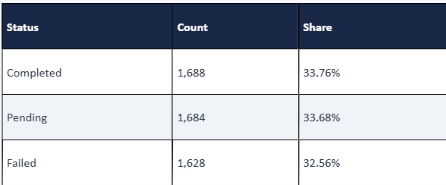
Objective-3:Transaction Analysis
Online has the highest reported transaction count and total value among the channels.
Pending and failed transactions together represent 66.24% of records.
The bank should investigate transaction statuses, especially failure reasons and pending transaction resolution.

Slide 12
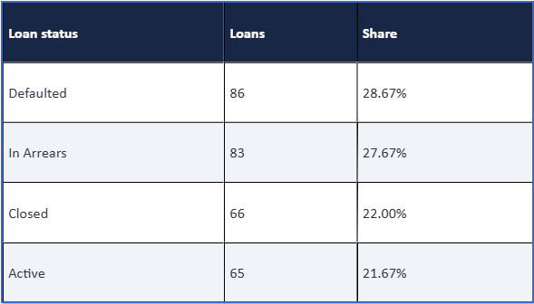
Objective-4:Loan Analysis
Loan-payment analysis showed 573 Paid payments, 500 Late payments, 468 Missed payments, and 459 Pending payments.
Home loans had the highest reported late-payment percentage among loan types: 28.16%
Education is largest outstanding loan type.
The bank could review repayment histories, identify customers with repeated missed payments, and introduce appropriate reminders or repayment-support measures.

Slide 13
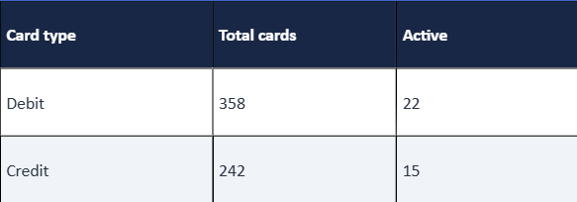
Objective-5:Card Analysis
Debit cards account for approximately 60% of the card records.
Visa has 159 cards, Mastercard has 153, American Express has 148, and Discover has 140.
The segment-level card analysis can help compare product engagement across Business, Retail, Senior, Student, Wealth, and Premium customers.

Slide 14
Overall Key Findings
The dataset contains 500 customers, 700 accounts, 5,000 transactions, 300 loans, 2,000 loan-payment records, 600 cards, and 40 branches.
Active accounts represent 71% of all accounts.
Online transactions have the highest reported total value among the transaction channels.
Pending and failed statuses account for 66.24% of transaction records combined.
Defaulted and in-arrears loans represent 56.33% of loan records.
Debit cards are more common than credit cards in the dataset.

Slide 15
Business Recommendations
Transaction monitoring: Analyse failed transactions by channel and type to identify
where further investigation is needed.
Pending transactions: Monitor pending records and establish appropriate resolution
and follow-up procedures.
Loan management: Prioritise repayment follow-ups for in-arrears loans and monitor
missed payments.
Customer segmentation: Use customer segments and product ownership to
understand differing banking needs.
Account management: Examine closed accounts by account type, branch, and region.
Card engagement: Compare card type, network, and utilisation across customer
segments.

Slide 16
Conclusion
The Retail Bank Transaction Analysis project demonstrates how SQL can be used to analyse relational banking data and answer business questions.
Using SQL queries, the project examined customer segments, account distribution, transaction patterns, loan statuses, repayment behaviour, and card distribution.
The analysis identified important patterns in account activity, transaction outcomes, and loan repayment risk. These findings can help guide further investigation and support more informed business decisions.
Learning outcome: Improved practical understanding of relational databases, SQL querying, data aggregation, joins, and communicating business insights.

Slide 17

THANK YOU

